Slide 1

3D Modeling
Tutor : Liyan Chen
Email: chenliyan@xmu.edu.cn

Slide 2
Chapter 9
Render

Slide 3
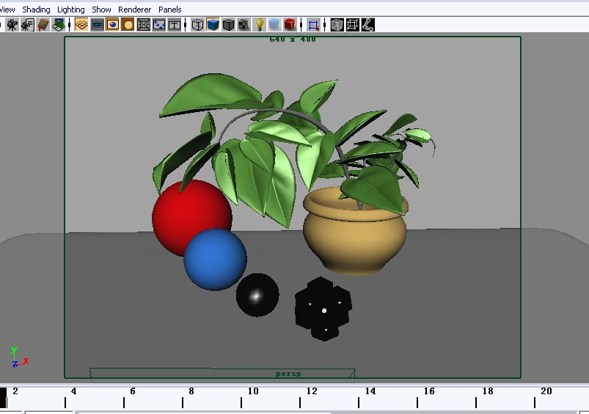

1. About Render
。
In computer graphics, render means the process of image is generated by software from the model. Rendering in video editing also used to describe the effect of video editing files generated video output process.

Slide 4

2. Render Methods
* Rendering in the process of production can be divided into test rendering and batch render.
* Tries to distinguish from the rendering calculation, and it can be divided into hardware, software and vector rendering.

Slide 5
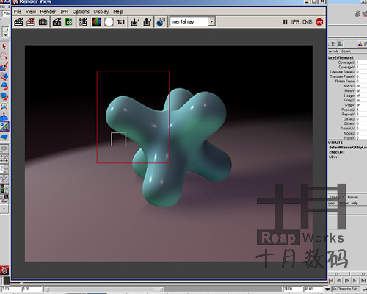
* IPR (Real-time rendering)

Slide 6
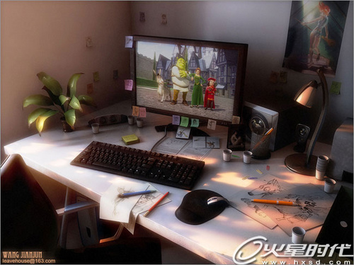
* Software render (Software, Mental ray)

Slide 7
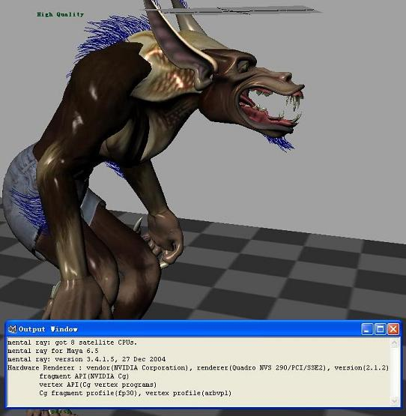
* Hardware render

Slide 8
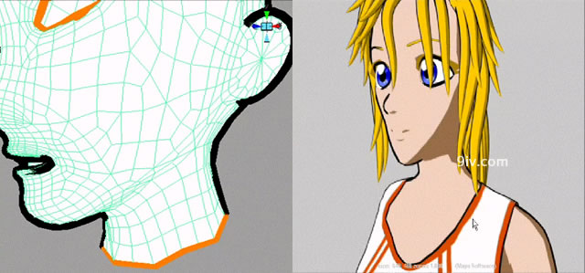
* Vector render

Slide 9
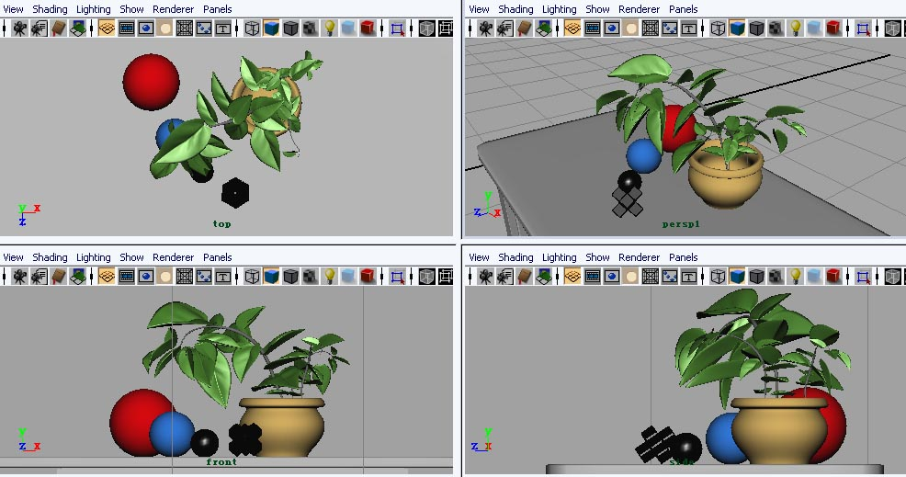
3. Render Process
（1） Layout Camera

Slide 10
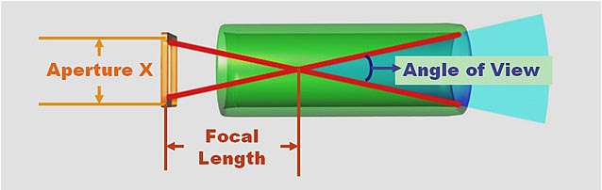

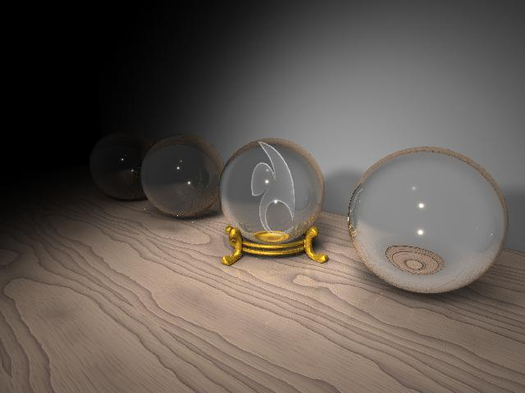



（2）Set the camera properties

Slide 11



（3）Adjust the render elements
高光
折射
漫反射
反射
阴影

Slide 12
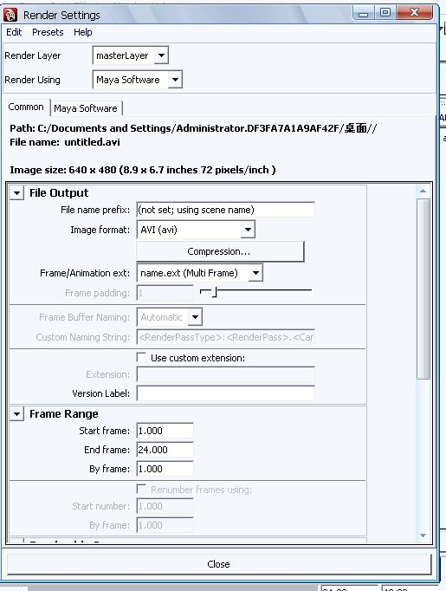
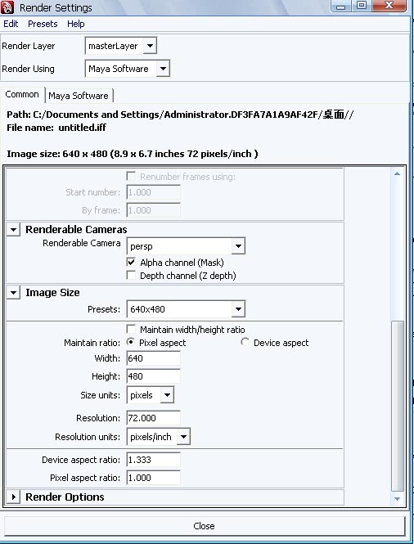
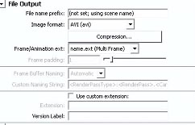

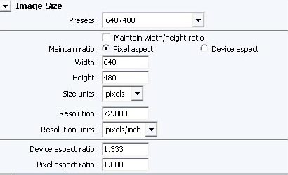
（4）Render Settings and rendering
渲染器
文件输出
渲染摄像机
渲染尺寸

Slide 13
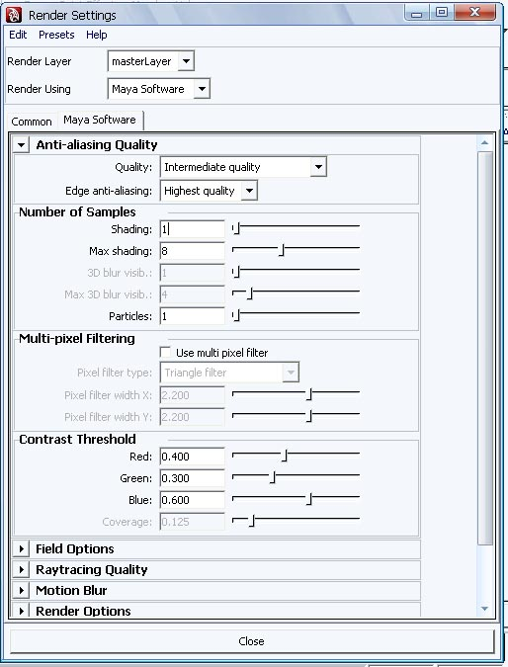
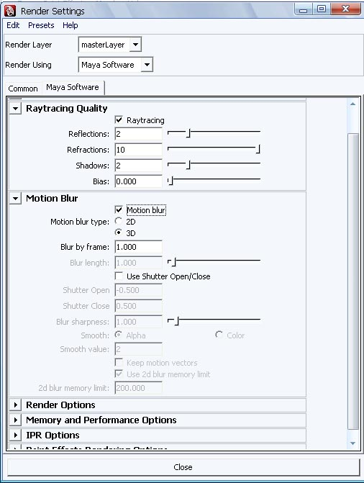
文件质量
光线跟踪
运动模糊

